Slide 1

2023-24 Odd Semester TRAINING ON DATA STRUCTURES Linked List ADT

Slide 2
Topics to be covered
Doubly Linked List
Circular Linked List
Applications of List

Slide 3

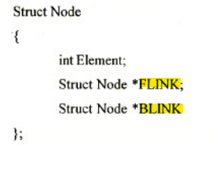
Doubly Linked List
Each node contains two links namely forward link and backward link.

Slide 4
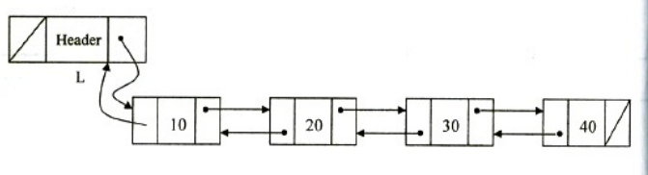
Example for DLL

Slide 5
Operations in DLL – Structure declaration
struct node
{
int element;
struct node *flink;
struct node *blink;
};

Slide 6
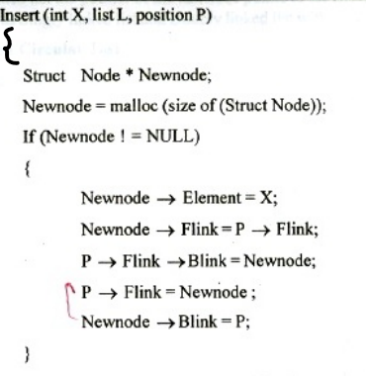
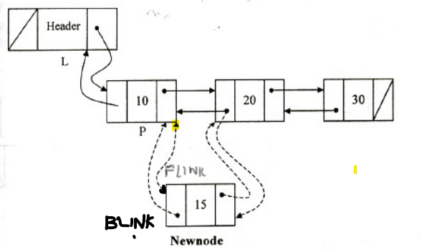
Inserting an element in a DLL

Slide 7
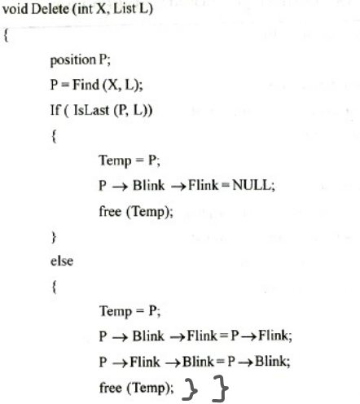
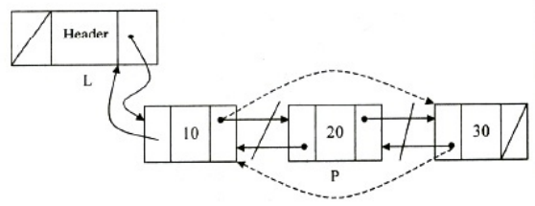
Deleting an element from a DLL

Slide 8
Features of DLL
Advantages
Deletion operation is easier
Finding the predecessor and successor node is easier
Disadvantages
Consumes more memory space as it has 2 pointer fields.

Slide 9
Circular linked list
In CLL, the pointer of the last node points to the first node
Can be implemented in two ways – Singly linked list and Doubly linked list with or without headers
In a singly linked circular list, the last node of the list points to the first node.
In a doubly linked circular list, forward link of the last node points to the first node and backward link of the first node points to the last node.

Slide 10
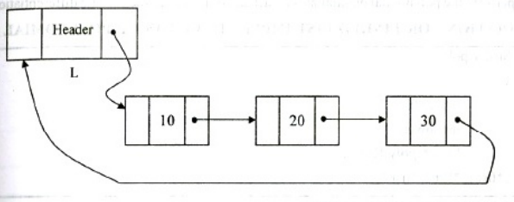
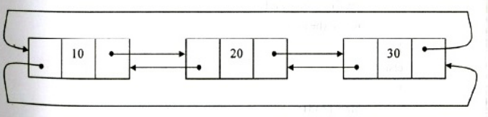
Singly linked and Doubly linked circular list

Slide 11
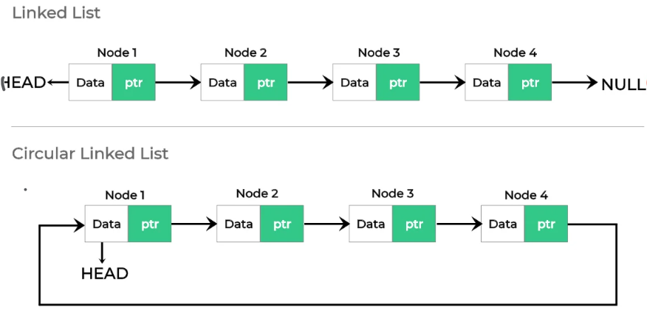
Comparison of Linked list and Circular linked list

Slide 12
Advantages of Circular linked list
It allows to traverse the list starting at any point
It allows quick access to the first and last records
Doubly linked circular list allows to traverse the list in any direction.

Slide 13
Applications of Linked List
Polynomial Manipulation
Radix sort 45, 34, 21, 09, 03, 12
21, 12, 03, 34, 45, 09
03, 09, 12, 21, 34, 45
Multi list

Slide 14
Polynomial addition
Polynomial 1
5x² + 3x – 10
Polynomial 2
7x² – 8x + 4
Resultant polynomial
12x² -5x – 6

Slide 15
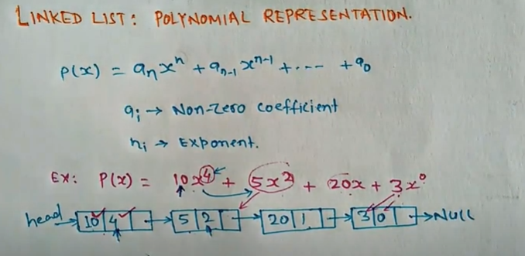
Representation of Polynomial as linked list

Slide 16
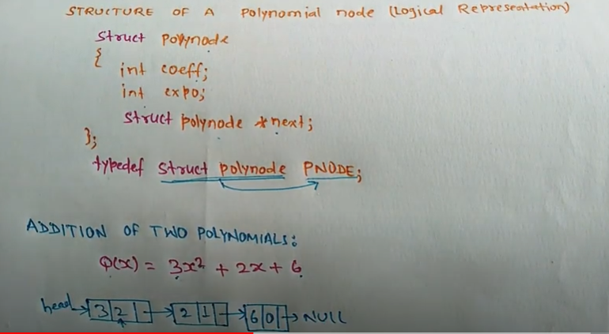

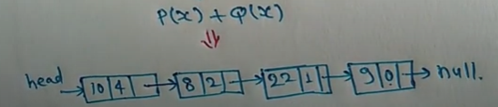
Logical representation of a Polynomial node

Slide 17
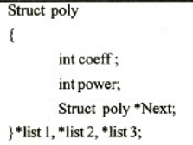
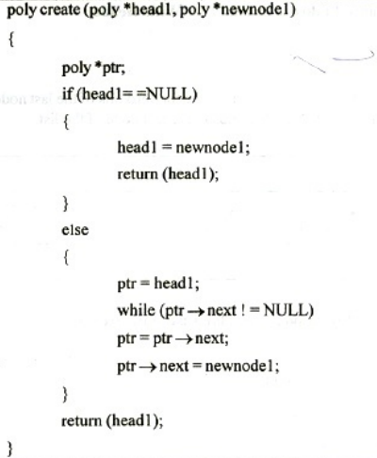
Routine for Polynomial addition

Slide 18
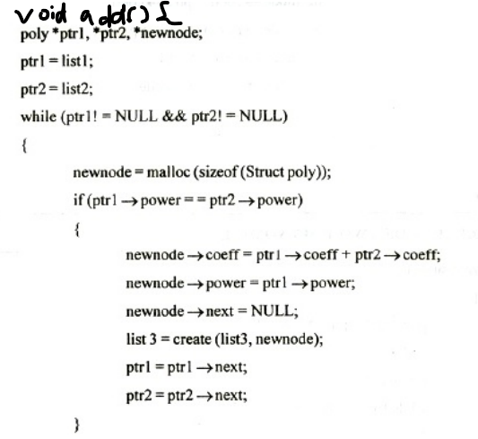
Routine for Polynomial addition

Slide 19
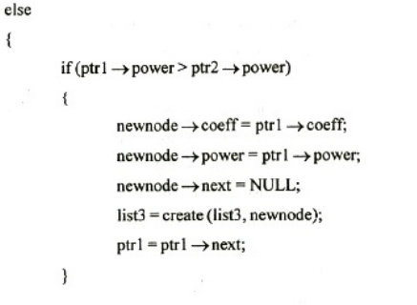
Routine for Polynomial addition

Slide 20
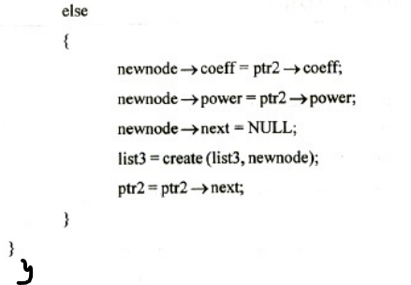
Routine for Polynomial addition

Slide 21
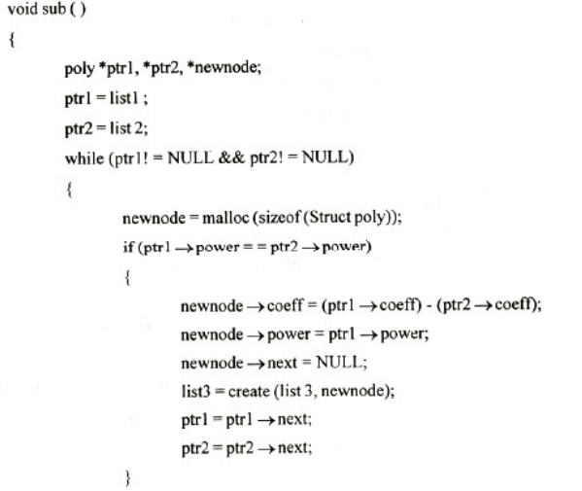
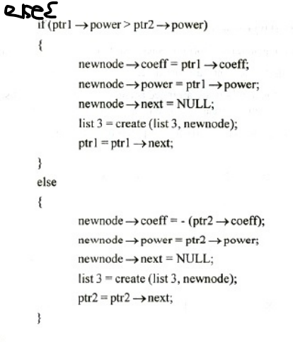
Routine for Polynomial subtraction

Slide 22
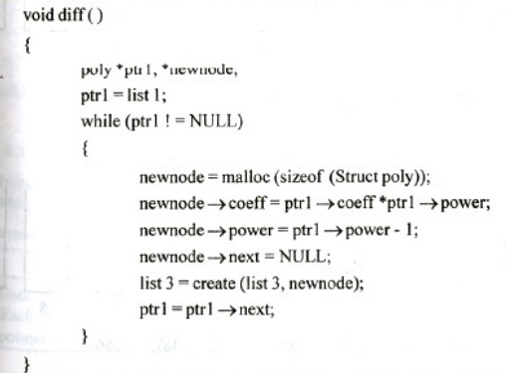
Routine for Polynomial Differentiation

